Slide 1
9:45-10:15 Bot Architectures

Slide 2
Reference Architectures and Bot Framework SDK v4

Slide 3
Session objectives and takeaways
At the end of this session, you should be able to…
Articulate the key scenarios for bots and their associated architectures
Explain common patterns for bots and the best practices for dealing with them
Prepare for the release of the new bot framework SDK

Slide 4
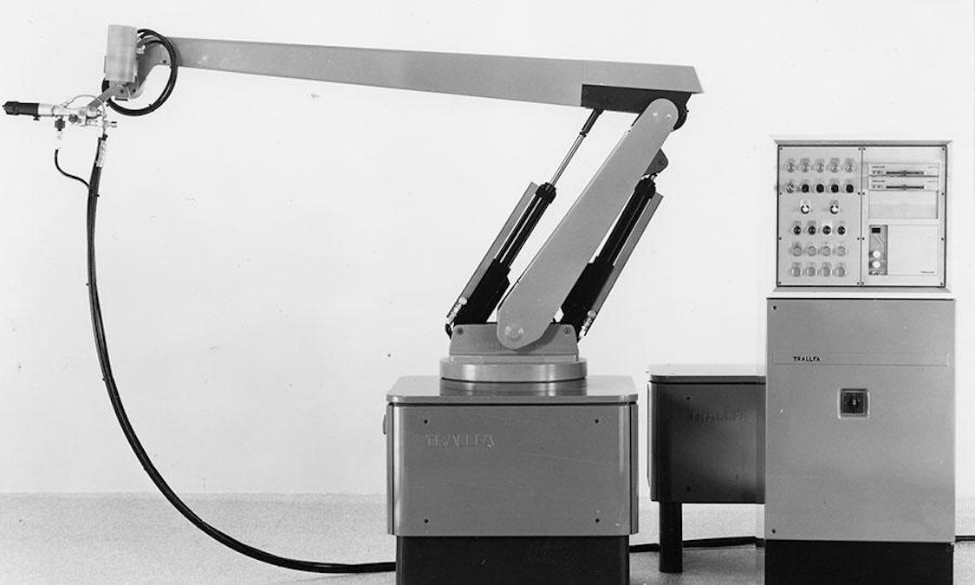
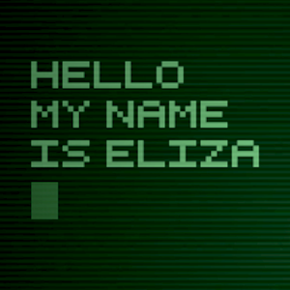
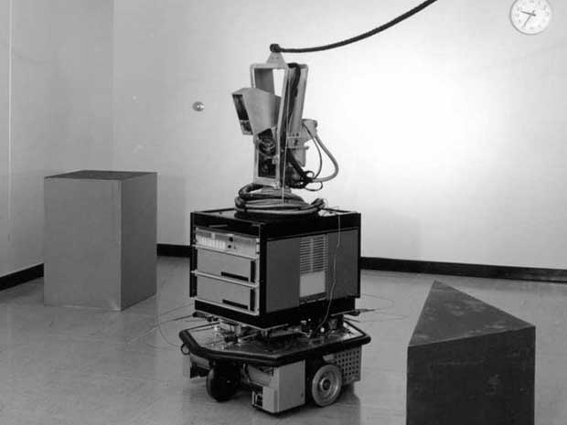
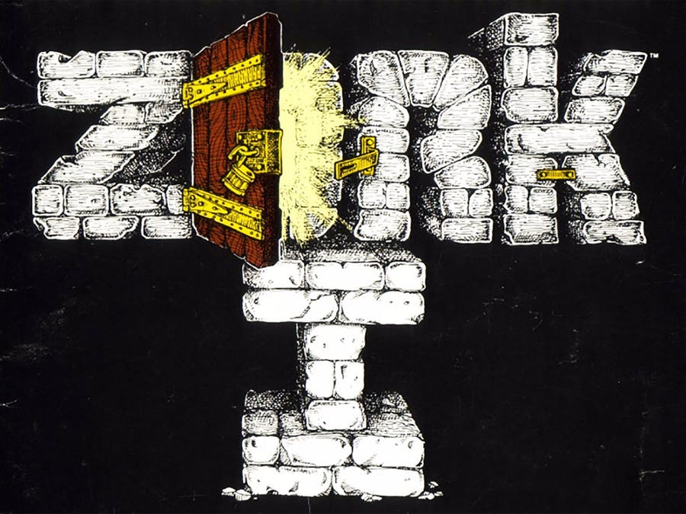
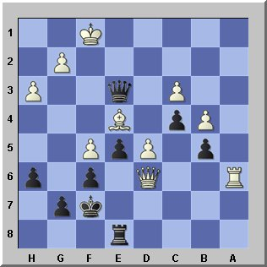
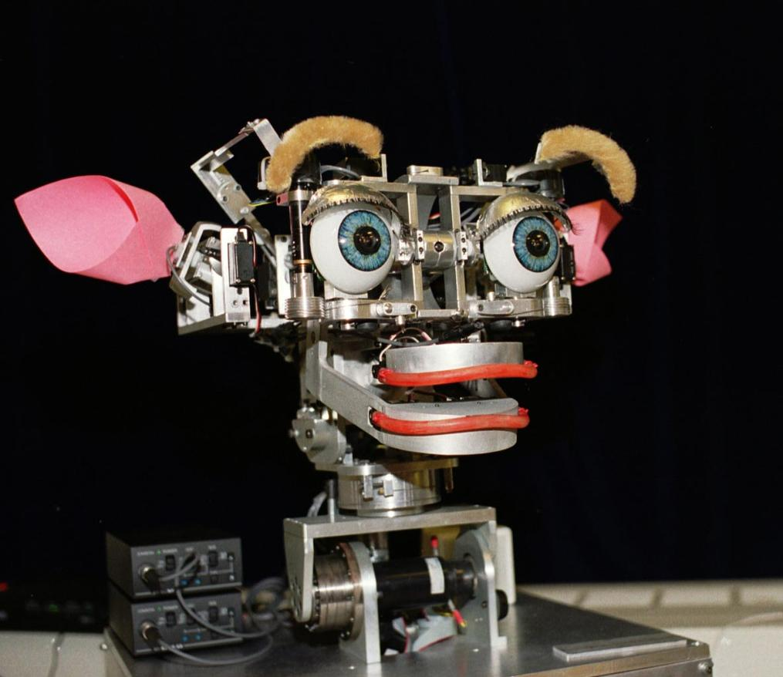
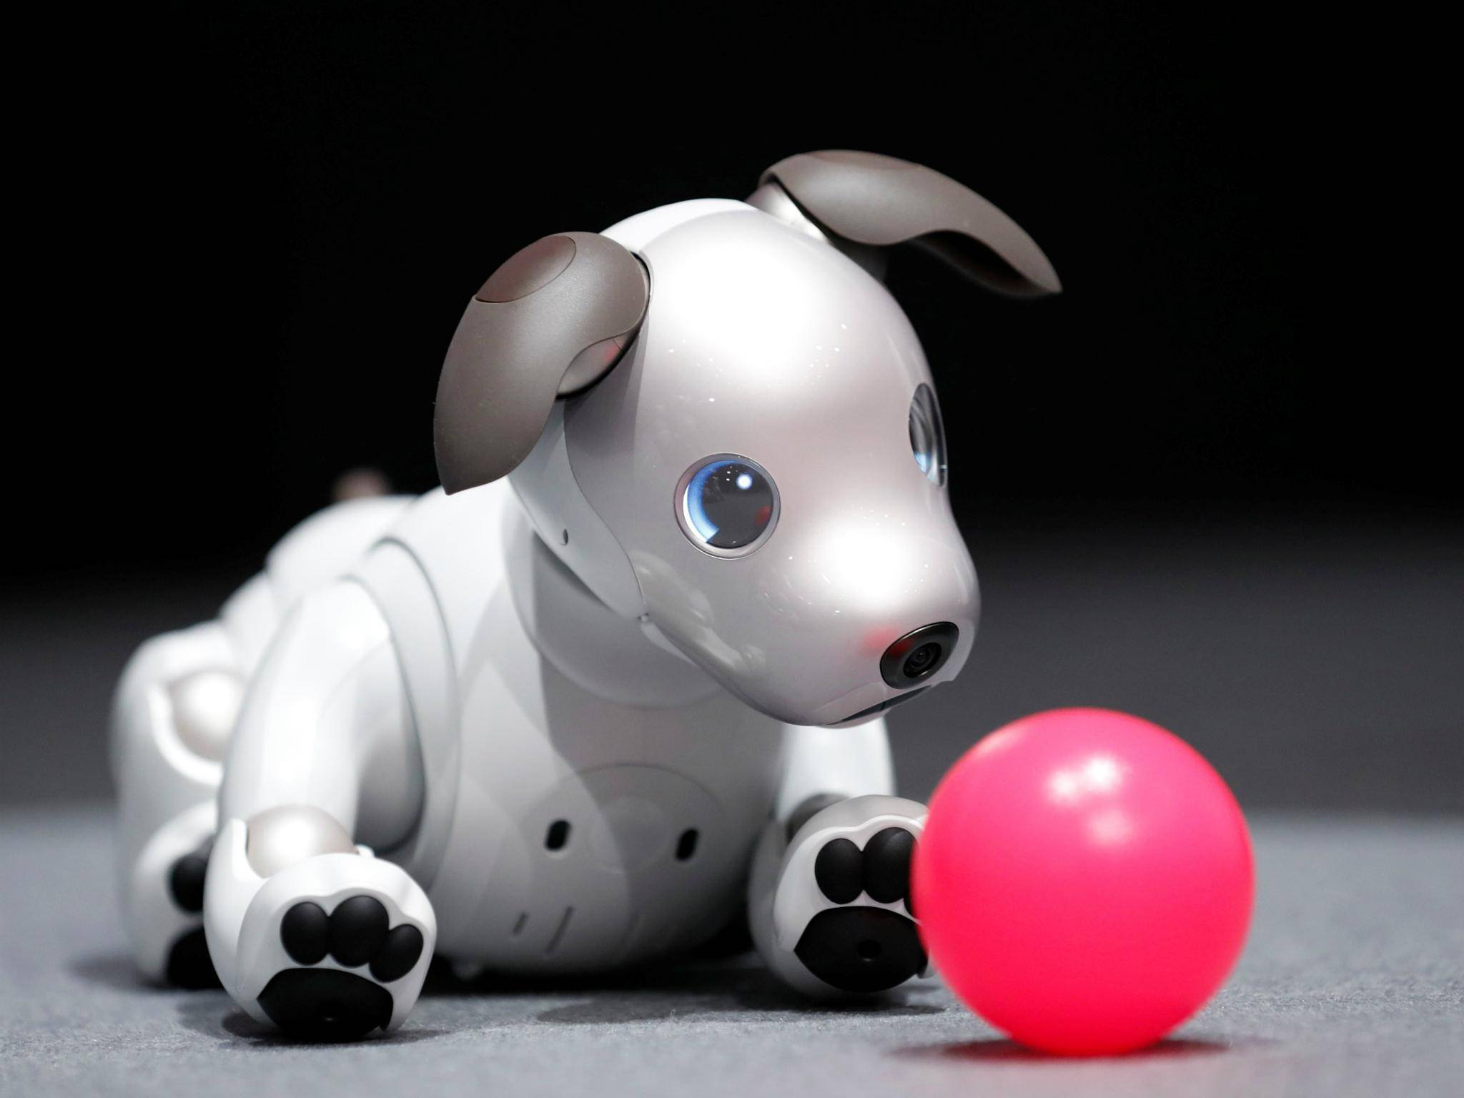
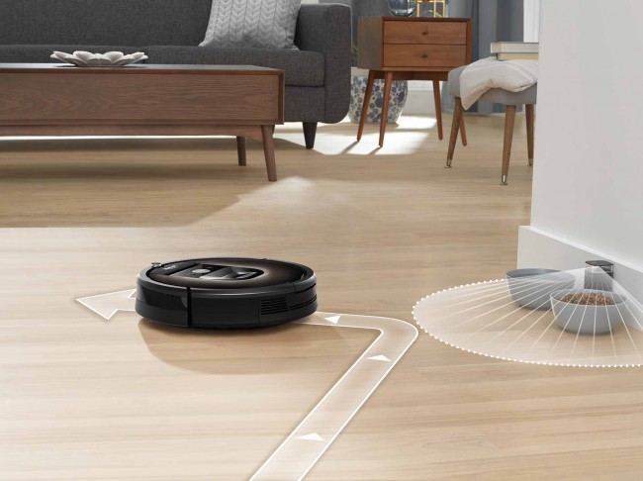
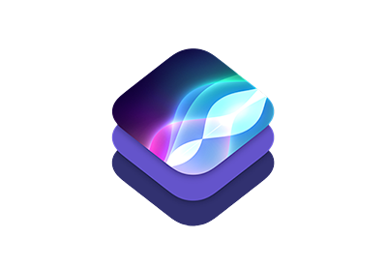
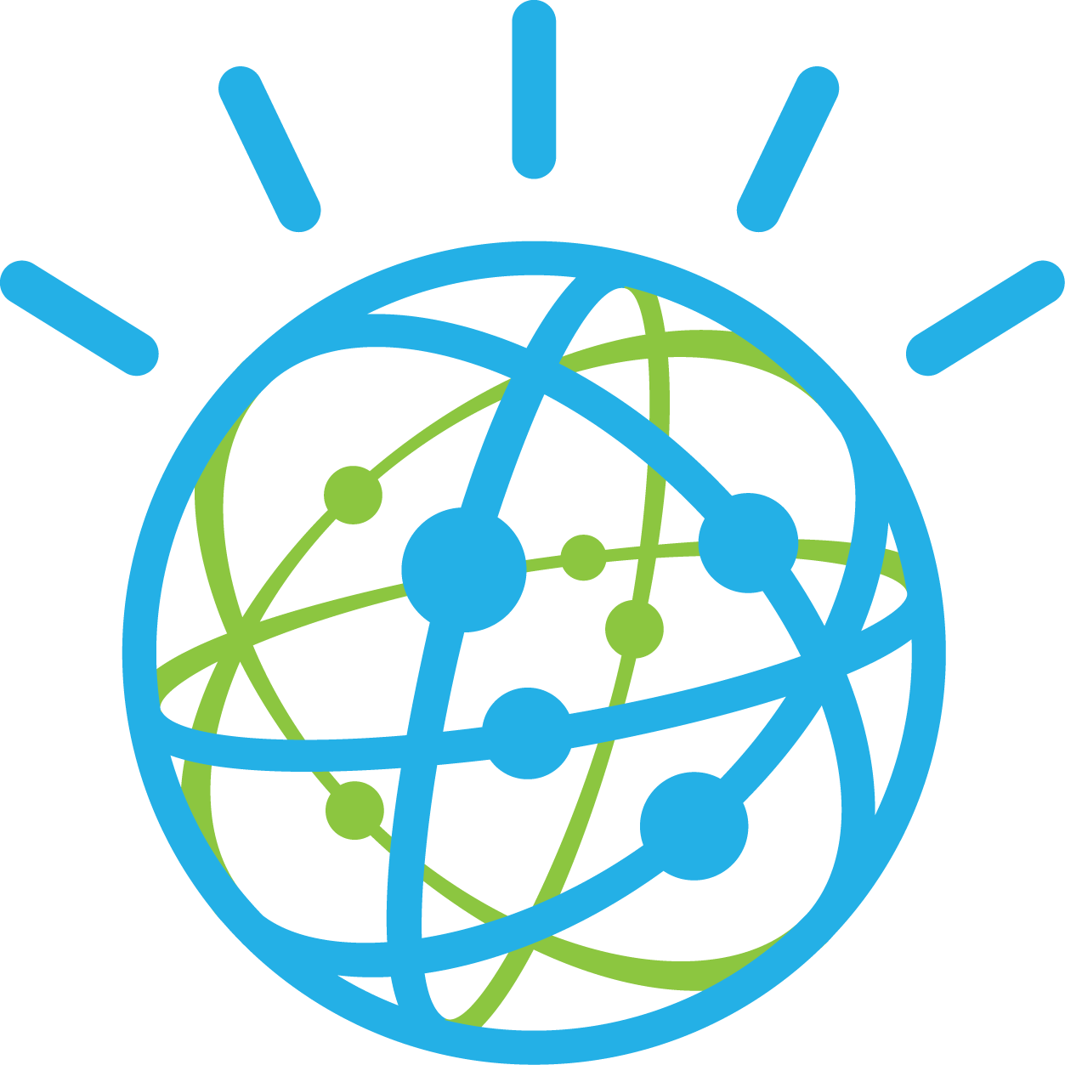

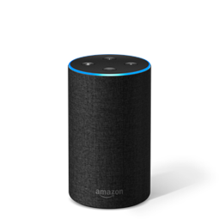
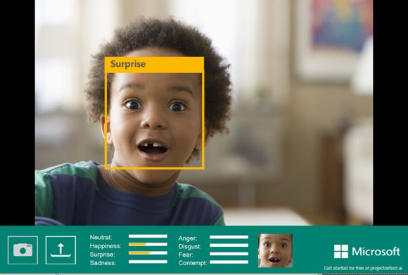

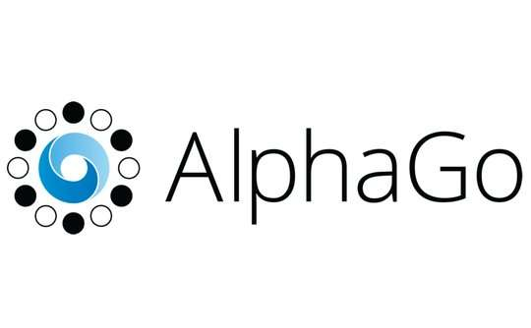
Bots are not new
1950 Turing Test
1955 AI Born
1961 Unimate
1964 Eliza
1966 Shakey
1977 Zork
1997 Deep Blue
1998 Kismet
1999 Aibo
Computer scientist Alan Turing proposes a test for machine intelligence.
Term “Artificial Intelligence” is coined by computer scientist John McCarthy
First industrial robot, Unimate, goes to work at GM replacing humans on the assembly line
Pioneering chatbot developed by Joseph Weizenbaum at MIT holds conversations with humans
The ‘first electronic person’ from Stanford, Shakey was a general-purpose mobile robot which reasoned about its own actions
One of the earliest interactive fiction games, included a sophisticated text parser that was not limited to simple verb-noun commands
Deep Blue, a chess-playing computer from IBM defeats world chess champion, Garry Kasparov
Cynthia Breazeal at MIT introduces KISmet, an emotionally intelligent robot that detects and responds to people’s feelings
Sony launches first consumer robot pet dog AiBO (AI robot) with skills and personality that develop over time
2002 Roomba
2011 Siri
2011 Watson
2014 Eugene
2014 Alexa
2015 Project Oxford
2016 Tay
2017 AlphaGo
First mass produced autonomous robotic vacuum cleaner from iRobot learns to navigate and clean homes
Apple integrates Siri, an intelligent virtual assistant with a voice interface, into the iPhone 4S
IBM’s question answering computer Watson wins first place on popular television quiz show Jeopardy
Eugene Goostman, a chatbot passes the Turing Test with a third of judges believing Eugene is human
Eugene Goostman, a chatbot passes the Turing Test with a third of judges believing Eugene is human
Microsoft releases Project Oxford, a collection of tools that allow developers to integrate AI capabilities into their apps.
Microsoft’s chatbot Tay goes rogue on social media making inflammatory and offensive racist comments
Google’s AlphaGo beats world champion Ke Jie in the complex game of Go, notable for its vast number (2*170) of possible positions
source: https://digitalintelligencetoday.com
Notes:
I’m not going to cover all of these events, but I do want to hit a few highlights…
Back in 1950, a mathematician named Alan Turing proposed a test to answer the question of whether machines are technically capable of showing intelligent behavior. He based the test on a party game where a man and a woman go into separate rooms, and then the other partygoers have to try and tell them apart by sending them questions and reading their typewritten responses. In the Turing Test, one of the rooms contains a computer — and if it can fool the partygoers into thinking it’s a human, then it passes the test.
In 1964 a researcher at MIT developed ELIZA, an early natural language processing program. Eliza simulated conversation by using a 'pattern matching' and substitution methodology that gave users an illusion of understanding on the part of the program, but had no built in framework for contextualizing events.
Jumping forward to 1977, we get to Zork. Now granted Zork isn’t really a bot in the context that we have defined, but it did introduce a number of features that still influence bot creators to this day. One of these key features was a word parser that took words the players typed and translated them into commands the game could process and respond to, propelling the story forward.
The parser allowed Zork to understand far more words than previous games, including adjectives, conjunctions, prepositions, and compound verbs. That meant Zork could support intricate puzzles, such as one that let players obtain a key by sliding paper under a door, pushing the key out of the lock so it would drop onto the paper, and retrieving the paper. The parser also let players input sentences like “Take all but rug” to scoop up multiple treasures, rather than making them type “Take [object]” over and over.
Elizabeth Woyke did a very interesting article called The Enduring Legacy of Zork for MIT Technology Review that is worth a read.
In 2014, 64 years after Alan Turing proposed a method of testing whether a machine has obtained human-level intelligence, a 13-year-old AI boy called Eugene Goostman finally became the first artificial intelligence to pass the Turing Test.
In 2015, Microsoft released Project Oxford which has since become Cognitive Services. These are a collection of AI enabled SDKs that cover a broad ecosystem that includes natural language processing, facial and voice recognition, sentiment analysis, content moderation… the list goes on. We’ll use some of these tools later today in one of our labs.
The following year, Microsoft introduced Tay. Tay was originally launched to test and improve Microsoft's understanding of conversational language. Unfortunately, right after Tay launched people started sending her racist and inflammatory tweets, and Tay – being basically a parrot with an internet connection - started spewing these things back proving the old programing rule of Garbage In – Garbage Out.
Now to be fair to Tay, most of the worst things she said were because she had a “Repeat After Me” feature that users were exploiting.
Tay is gone but I think she can teach us a lot of valuable lessons. Most importantly is that a bot is like any other program, and if as developers we don’t anticipate or plan for exceptions in our code, we can inadvertently introduce vulnerabilities that people can, and will take advantage of.

Slide 5
Agenda
Key scenarios for bots
Common patterns
New Bot Framework SDK
Notes:
Key scenarios for bots – 10-15 minutes
Common patterns – 5-10 minutes
New Bot Framework SDK – 5-10 minutes
QnA – remaining time

Slide 6
Key scenarios for bots
Cortana
Enterprise Productivity
Information
Internet of Things (IoT)
Commerce
Notes:
Key scenarios for bots: https://docs.microsoft.com/en-us/azure/bot-service/bot-service-scenario-overview

Slide 7
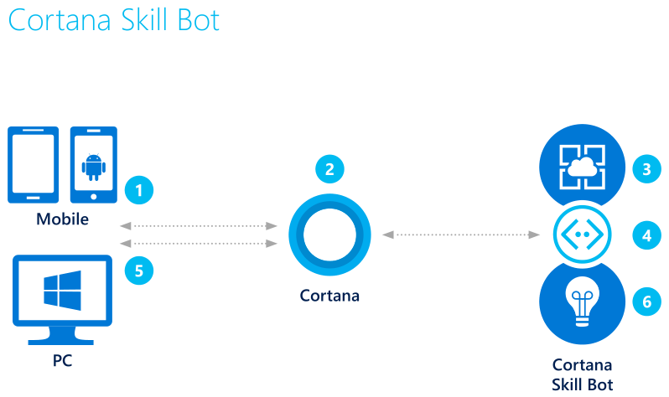
Cortana skills bot
Cortana skills bot
3. Bot accesses user’s calendar and applies logic to the request
Example: Auto appointment
2. Using either text or voice commands, the user asks for an automobile maintenance appointment
1. The user accesses Cortana from their PC or mobile device
4. Queries the auto service for valid appointments
5. Bot presents user with options, user can book appointment
6. Application insights gathers runtime telemetry to help development with bot performance and usage
Key scenarios for bots
Notes:
I like to start with this architecture because it’s fairly simple. We can see on the left, the user accesses the bot however is convenient for them, Cortana in the middle is the link between the user and the bot service. So let’s walk through the scenario for an auto shop bot.
Transition – you can use many different channels. This is an older architecture. What I want to share is that you can build for one and deploy to many by using Azure Bot Service, so it doesn’t have to explicitly be a cortana skills bot
Cortana skills scenario: https://docs.microsoft.com/en-us/azure/bot-service/bot-service-scenario-cortana-skill
Build a speech-enabled bot with Cortana skills: https://docs.microsoft.com/en-us/azure/bot-service/dotnet/bot-builder-dotnet-cortana-skill
Cortana skills kit: https://docs.microsoft.com/en-us/cortana/skills/overview
Cortana skills samples: https://docs.microsoft.com/en-us/cortana/skills/cortana-samples

Slide 8
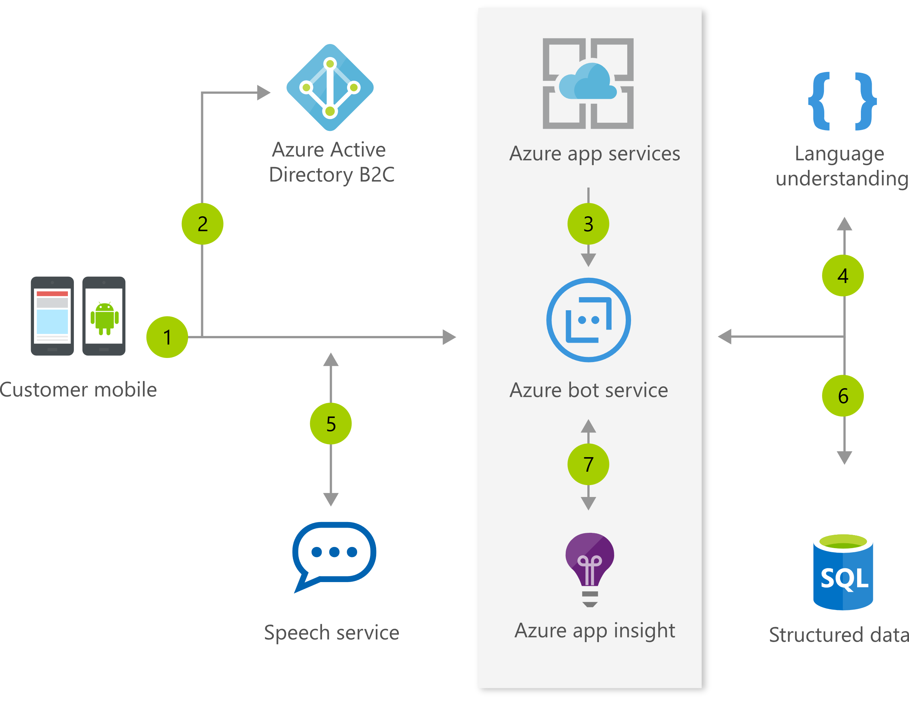
Cortana skills bot
Commerce bot
3. Using the bot in the mobile app, user requests information
Example: Hotel concierge service
4. Cognitive Services used to process the natural language request
2. Using Azure AD B2C, the user authenticates
LUIS
Text Analytics API
Speech API
1. The customer uses the hotel mobile app
5. Response is reviewed by customer who may then continue conversation with natural language
6. After the user is happy, mobile app bot updates customer’s reservation
Key scenarios for bots
Notes:
Speaking of Azure Bot Service, let’s talking about the Commerce bot. What I want to point out here is that Azure app services, ABS, and Azure App insights all integrate really nicely within the azure portal, making it easier for you to dev and monitor.
Talk through the architecture
I am going to tell a story about a customer Telefonica, because they used a similar scenario as this except it’s real and huge.
To change how it engages with customers, the multinational telco Telefonica used Microsoft Azure Bot Service and Cognitive Services to build and support Aura, an intelligent conversational agent for multiple services. With Aura, Telefonica customers can manage their products and services with the company, get real-time support, or just change the TV channel, all through natural voice interaction and personalized user experience. Telefonica took advantage of how you can easily deploy bots to multiple channels. Depending on the country and user preference, users can interact with Aura via Cortana, their TV provider's app, Facebook Messenger, and more. I recommend watching this video about Aura and reading the full story.
Here is the logic flow of a Commerce bot that functions as a concierge for a hotel:
The customer uses the hotel mobile app.
Using Azure AD B2C, the user authenticates.
Using the custom Application Bot, user requests information.
Cognitive Services helps process the natural language request.
Response is reviewed by customer who can refine the question using natural conversation.
After the user is happy with the results, the Application Bot updates the customer’s reservation.
Application insights gathers runtime telemetry to help development with bot performance and usage.

Slide 9
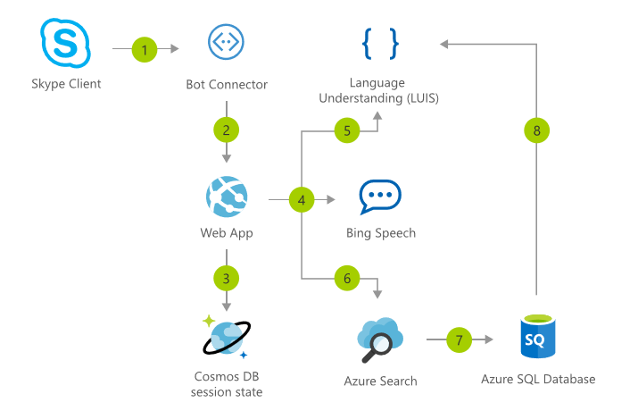
Cortana skills bot
Commerce bot - aside
AI Gallery Solution: IVR Bot – Bike Store
Key scenarios for bots
Notes:
As an aside.. The AI Gallery is where you can find prebuilt solutions to meet various needs - demos, POCs, tutorials, and more. We picked a solution around interactive voice response bots. This specific solution allows you to 1-click deploy or build from scratch an IVR (interactive voice response) bot for a Bike Store. You can read more about the solution here, but we've included the architecture below:
Point out the decision to use Cosmos DB to manage session state
Solution: https://azure.microsoft.com/en-us/solutions/architecture/interactive-voice-response-bot/

Slide 10
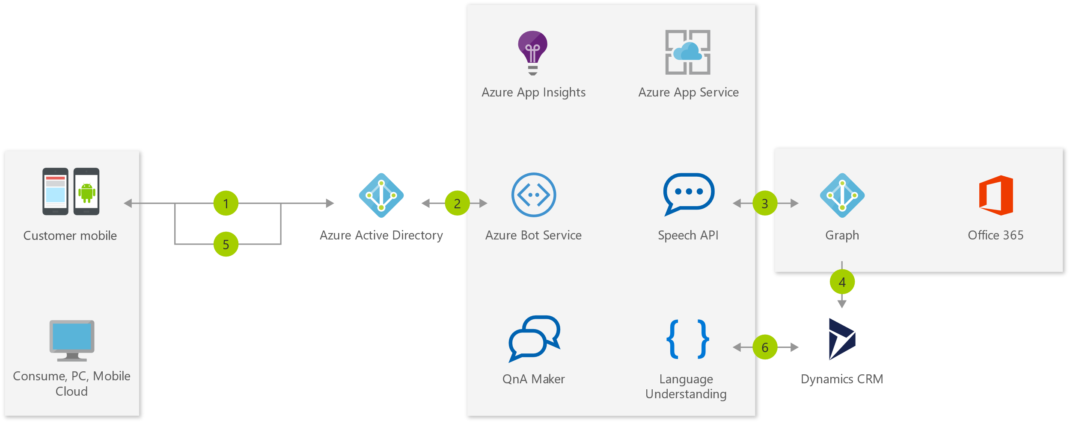
Enterprise Productivity bot
Enterprise Productivity bot
Example: Access other services
3. The bot is able to query the employee’s O365 calendar via Azure Graph
1. The employee accesses the bot
7. Application insights gathers runtime telemetry
5. The information is returned to the employee who can filter down the data from the bot
2. AAD validates the employee’s identity
4/6. Using data gathered from the calendar, the bot accesses case information in Dynamics CRM
Key scenarios for bots
Notes:
Brief overview/explanation of why enterprise productivity bot is needed
Again, here’s the architecture, which you can look at, now or later, but I’m going to tell another story about Apttus
Let's talk about Apttus, a company that helps companies accelerate their digital transformation efforts and maximize business outcomes. They really committed to Microsoft's Azure platform and services (seriously, the list of Microsoft products that they use is overwhelming). Let's focus in on their AI-driven deal guidance that they developed for sales reps.
1 Employee access Enterprise Productivity Bot
2 Azure Active Directory validates the employee’s identity
3 The Bot is able to query the employee’s Office 365 calendar via the Azure Graph
4 Using data gathered from the calendar, the Bot access case information in Dynamics CRM
5 Information is returned to the employee who can filter down the data without leaving the Bot
6 Application insights gathers runtime telemetry to help the development with Bot performance and usage
Enterprise productivity scenario: https://azure.microsoft.com/en-us/solutions/architecture/enterprise-productivity-chatbot/
Enterprise productivity sample (v3 SDK): https://github.com/Microsoft/AzureBotServices-scenarios/tree/master/CSharp/Enterprise/src
Microsoft Graph: https://graph.microsoft.com/
Another Enterprise bot architecture: https://blogs.msdn.microsoft.com/pragdev/2018/02/10/enterprise-bot-architecture/
UST Global’s Bot Journey: https://customers.microsoft.com/en-us/story/ust-global-professional-services-microsoft-bot-framework-en

Slide 11
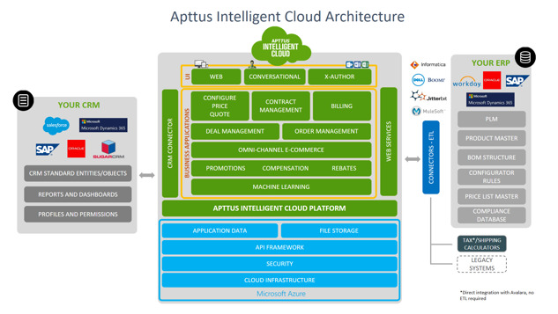
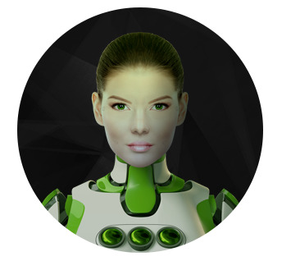
Enterprise Productivity bot - Apttus
Key scenarios for bots
Notes:
When a salesperson takes an action, the platform built is able to look at similar sales scenarios and advise the sales rep on the best, most profitable next step. Apttus gave their tech a human touch with a virtual assistant named Max who will guide the sales reps. In addition to interacting with sales reps, she can also carry out complex business processes that take hours for humans to complete. The architecture, the details (including Max's personality and contact photo), and a great story can be found here.
Enterprise productivity scenario: https://azure.microsoft.com/en-us/solutions/architecture/enterprise-productivity-chatbot/
Enterprise productivity sample (v3 SDK): https://github.com/Microsoft/AzureBotServices-scenarios/tree/master/CSharp/Enterprise/src
Microsoft Graph: https://graph.microsoft.com/
Another Enterprise bot architecture: https://blogs.msdn.microsoft.com/pragdev/2018/02/10/enterprise-bot-architecture/
UST Global’s Bot Journey: https://customers.microsoft.com/en-us/story/ust-global-professional-services-microsoft-bot-framework-en

Slide 12
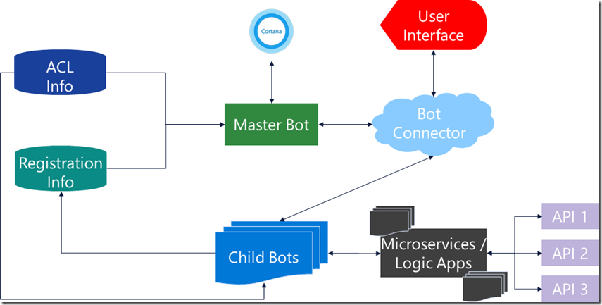
Enterprise Productivity bot
Aside: Creating Bots for Enterprises
Search for “Brad Lawrence Enterprise Bot Architecture Blog”
Key scenarios for bots
https://blogs.msdn.microsoft.com/pragdev/2018/02/10/enterprise-bot-architecture/
Notes:
Do any of you know Brad Lawrence? So I don’t have time to walk through this solution, but you really need to go read this article. Brad Lawrence is an amazing Architect who has worked on creating many enterprise bots for really big name companies (which I don’t think I can say). He wrote an article about a lot of the struggles he sees as large enterprises adopt bots, then other orgs within the enterprise create bots, and before you know it there are a mess of bots and maintenance and really work to get all the orgs on the same page. He recommends the solution here, but he also talks about the complexities and tips for implementation….you need to read this blog.

Slide 13
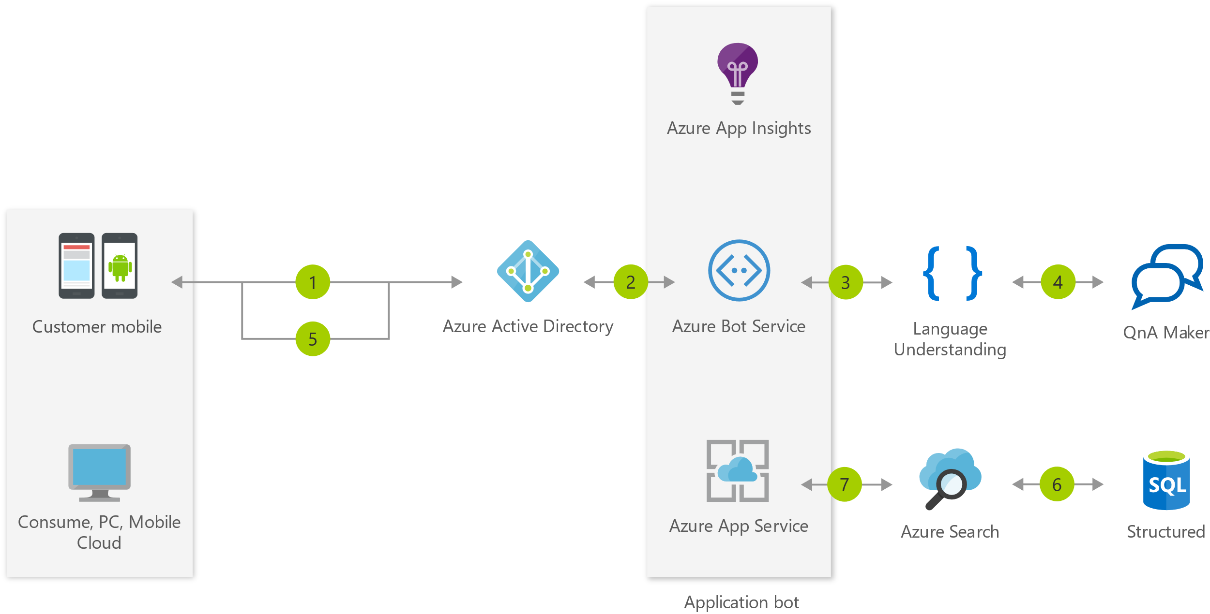
Information bot
Information bot
Example: Customer order status
7. Application insights gathers runtime telemetry
3. The employee can ask the bot what type of queries are supported
1. The employee starts the information bot
5. The employee responds with a valid query
2. AAD validates the employee’s identity
4. Using QnA Maker, the bot processes the request and gives answer
6. The bot submits the query to Azure Search which returns info from SQL to the user
Key scenarios for bots
Notes:
The Information bot scenario may be the one you've heard the most about. There are lots of use-cases for a bot like this, including: FAQ, IT support, store location and information, open-ended search, retail/inventory...the list goes on. An information bot could be used to answer questions defined in a knowledge set or even more open-ended questions.
Often information is buried in structured data stores like SQL Server that can be easily surfaced via search. Using Cognitive Services QnA Maker or Azure Search, you can make those searches possible with conversational commands.
I have a lot more stories to tell that I just can’t fit into an hour, but let me tell one about the City of Los Angeles, because that’s where I live.
A bot doesn't have to be super complicated or intelligent to be effective. Take the City of Los Angeles, for example. They implemented a chatbot named Chip to help answer questions that LA citizens have regarding city services. Taking only a few days to set up and deploy, a few developers built Chip, who is simply a QnA bot. In the first two months of Chip’s beta release, the chatbot went from offering 200 answers to 900 answers, and the agency is still adding more. Developers are able to review the questions received and update answers easily, which added to Chip's value.
1 Employee starts the Application Bot
2 Azure Active Directory validates the employee’s identity
3 The employee can ask the bot what type of queries are supported
4 Cognitive Services returns a FAQ built with the QnA Maker
5 The employee defines a valid query
6 The Bot submits the query to Azure Search which returns information about the application data
7 Application insights gathers runtime telemetry to help development with Bot performance and usage
Information scenario: https://azure.microsoft.com/en-us/solutions/architecture/information-chatbot/
Information sample (v3 SDK): https://github.com/Microsoft/AzureBotServices-scenarios/tree/master/CSharp/Informational/src
Navitime chatbot to help tourists get around Japan: https://customers.microsoft.com/en-us/story/navitime-japan-travel-hospitality-microsoft-cognitive-services
Fiducia & GAD IT AG using bots for customer services and support: https://customers.microsoft.com/en-us/story/fiducia-gad-cortana-azure-powerbi-services-bot-framework-banking-germany-en

Slide 14
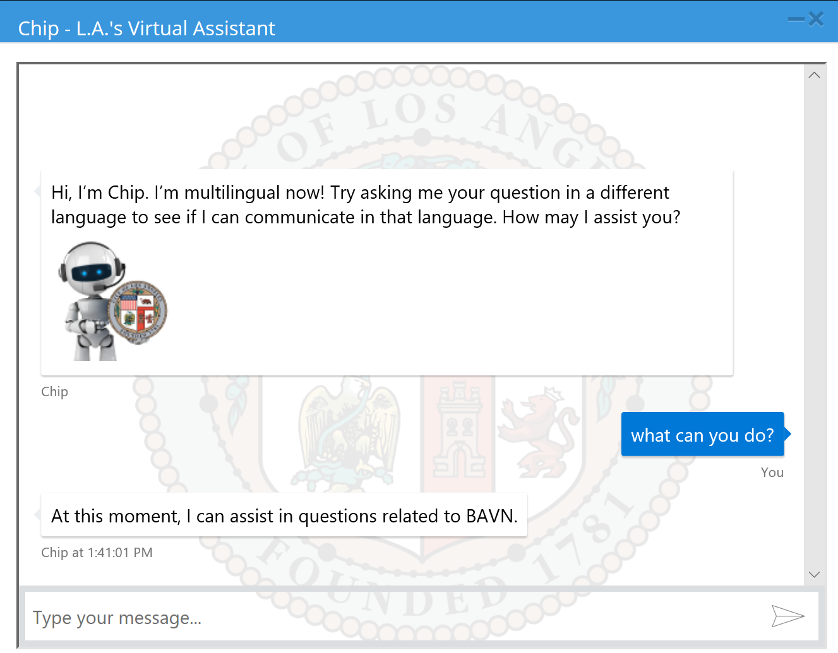
Information bot
Information bot - Chip
Key scenarios for bots
Notes:
I have a lot more stories to tell that I just can’t fit into an hour, but let me tell one about the City of Los Angeles, because that’s where I live.
A bot doesn't have to be super complicated or intelligent to be effective. Take the City of Los Angeles, for example. They implemented a chatbot named Chip to help answer questions that LA citizens have regarding city services. Taking only a few days to set up and deploy, a few developers built Chip, who is simply a QnA bot. In the first two months of Chip’s beta release, the chatbot went from offering 200 answers to 900 answers, and the agency is still adding more. Developers are able to review the questions received and update answers easily, which added to Chip's value.
1 Employee starts the Application Bot
2 Azure Active Directory validates the employee’s identity
3 The employee can ask the bot what type of queries are supported
4 Cognitive Services returns a FAQ built with the QnA Maker
5 The employee defines a valid query
6 The Bot submits the query to Azure Search which returns information about the application data
7 Application insights gathers runtime telemetry to help development with Bot performance and usage
Information scenario: https://azure.microsoft.com/en-us/solutions/architecture/information-chatbot/
Information sample (v3 SDK): https://github.com/Microsoft/AzureBotServices-scenarios/tree/master/CSharp/Informational/src
Navitime chatbot to help tourists get around Japan: https://customers.microsoft.com/en-us/story/navitime-japan-travel-hospitality-microsoft-cognitive-services
Fiducia & GAD IT AG using bots for customer services and support: https://customers.microsoft.com/en-us/story/fiducia-gad-cortana-azure-powerbi-services-bot-framework-banking-germany-en

Slide 15
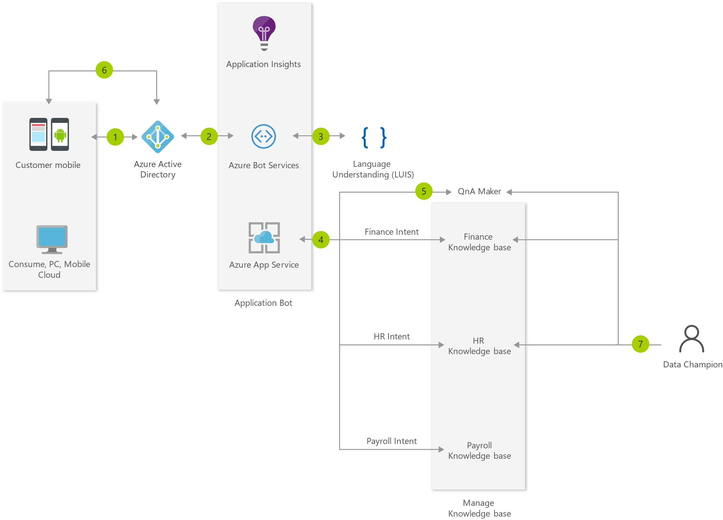
Information bot
Information bot
Example Architecture:
FAQ Bot for Enterprise
Key scenarios for bots
Notes:
Here’s another architecture for a FAQ bot in enterprise that you can look into later!
FAQ scenario: https://azure.microsoft.com/en-us/solutions/architecture/faq-chatbot-with-data-champion-model/
Process
Employee access FAQ Bot
Azure AD validates the employee’s identity
Query is sent to a LUIS model to get the intent of the query
Based on the intent, the query is redirected to the appropriate knowledge base
QnA Maker gives the best match to the incoming query
The result is shown to the employee
Data Champions manage and update their QnA Knowledge base based on the feedback from user traffic

Slide 16
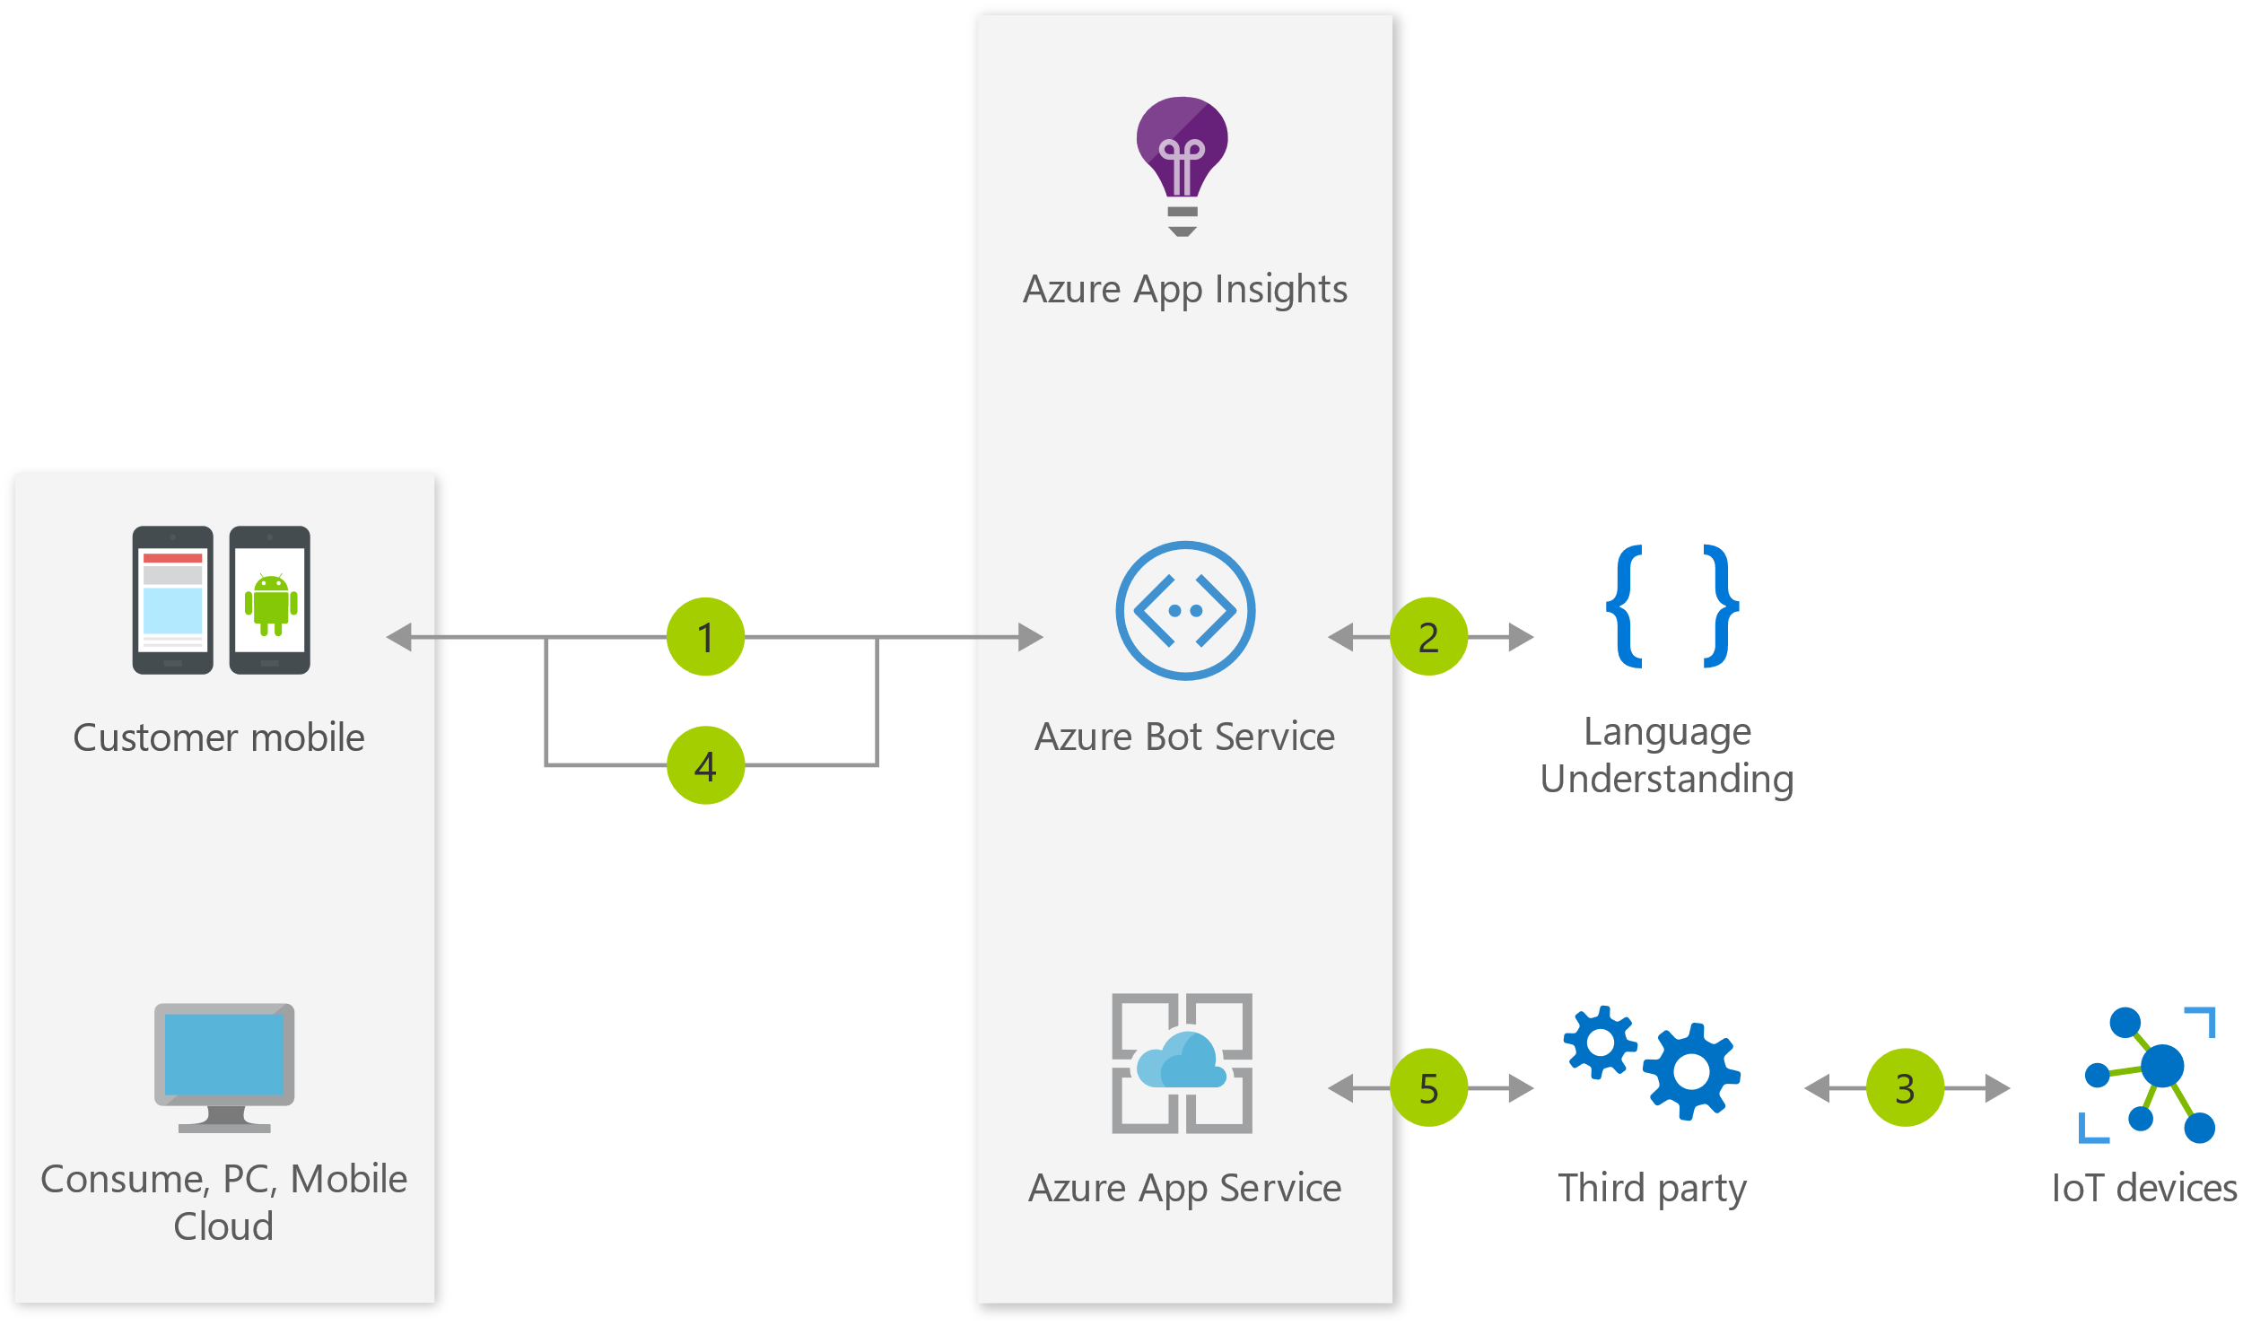
IoT bot
IoT bot
Example: Manage Philips Hue lights
5. Application insights gathers runtime telemetry
1. The accesses the IoT bot
2. Using voice or IM, the user asks the bot to turn on the lights via the IoT device
4. The results of the command are returned to the user
3. The request is relayed to a third party service that has access to the IoT device network
Key scenarios for bots
Notes:
The IoT bot makes it easy for you to control devices using voice or interactive chat controls. For this architecture, we'll be using the example of the Philips Hue light. This bot allows a person to manage a Philips Hue by simple chat commands or voice. In addition, when using chat, a person can be given visual choices related to colors to pick.
Almost all IoT scenarios could have a bot. While it will depend on the situation if a bot is the best way, using bots should definitely be considered.
IoT scenario: https://azure.microsoft.com/en-us/solutions/architecture/iot-devices/
IoT sample (v3 SDK): https://github.com/Microsoft/AzureBotServices-scenarios/tree/master/CSharp/Iot/src
IoT solutions: https://www.microsoft.com/en-us/internet-of-things/solutions

Slide 17
Common patterns
Task automation
Communicating with rich text and media
Access to knowledge and other content
Handling user interruptions
Bot to human handoff
Bot to web browser and back
Authentication
Bots in websites/apps

Slide 18
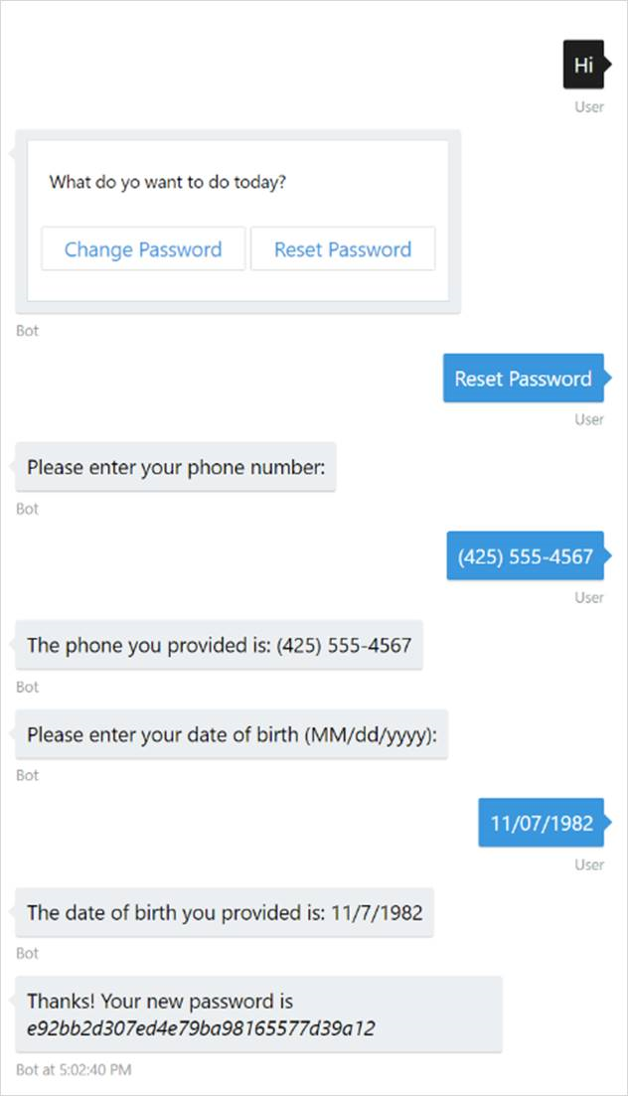
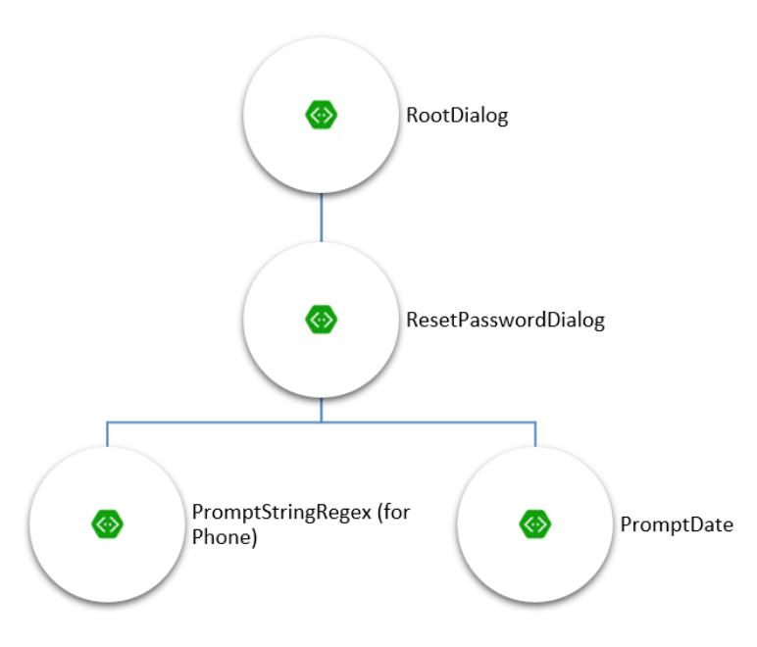
Task automation
Task automation
Example: password-reset
Common patterns
Notes:
Task automation documentation: https://docs.microsoft.com/en-us/azure/bot-service/bot-service-design-pattern-task-automation
Simple task automation sample (C# v3 SDK): https://github.com/Microsoft/BotBuilder-Samples/tree/master/CSharp/capability-SimpleTaskAutomation
Simple task automation sample (Node.js v3 SDK): https://github.com/Microsoft/BotBuilder-Samples/tree/master/Node/capability-SimpleTaskAutomation

Slide 19

Bots in websites
Communicating with rich text and media
Text versus spoken
Options
Attachment
Hero card
Adaptive card
Carousel of cards
Suggested actions
Common patterns
Notes:
Sending messages: https://docs.microsoft.com/en-us/azure/bot-service/bot-builder-howto-send-messages?view=azure-bot-service-4.0&tabs=csharp
Adaptive Cards documentation: https://docs.microsoft.com/en-us/adaptive-cards/
Sending rich media: https://docs.microsoft.com/en-us/azure/bot-service/bot-builder-howto-add-media-attachments?view=azure-bot-service-4.0&tabs=csharp
Using dialogs to manage conversation flow: https://docs.microsoft.com/en-us/azure/bot-service/bot-builder-dialog-manage-conversation-flow?view=azure-bot-service-4.0&tabs=csharp
Creating modular bot logic with Dialog Container: https://docs.microsoft.com/en-us/azure/bot-service/bot-builder-compositcontrol?view=azure-bot-service-4.0

Slide 20
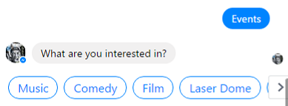
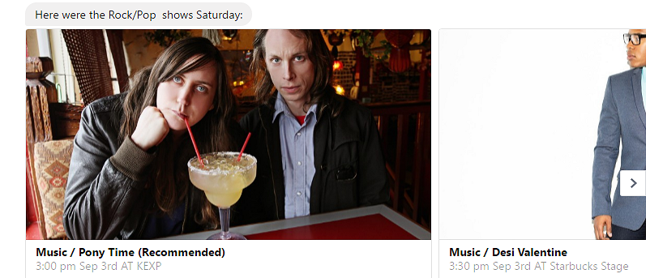
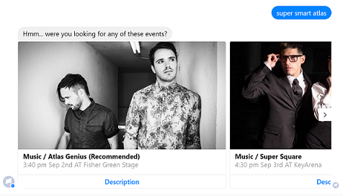
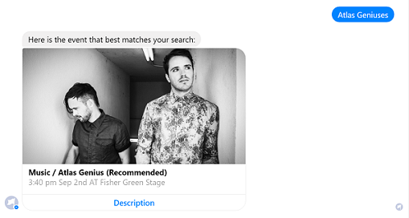
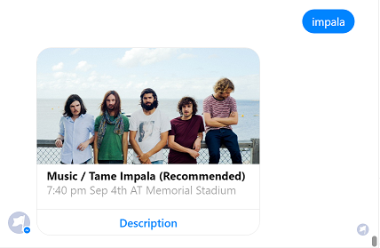
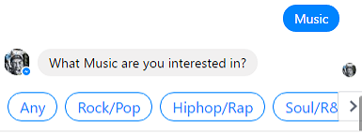
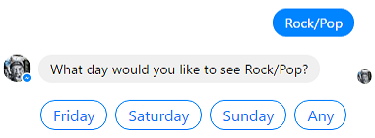
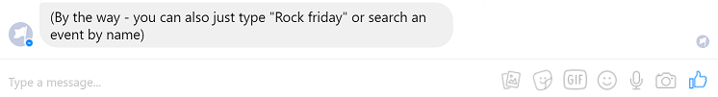
Access to knowledge and other content
Access to knowledge and other content
Azure Search
QnA Maker
LUIS
Bing APIs
Microsoft Graph
Common patterns
Notes:
Azure search: https://azure.microsoft.com/en-us/services/search/
QnA maker: https://www.microsoft.com/cognitive-services/en-us/qnamaker
Bootcamp Materials - Combing LUIS and Azure Search in Microsoft Bot Framework SDK v4 for .NET: https://github.com/Azure/LearnAI-Bootcamp/blob/master/emergingaidev_bootcamp.md
Search-powered bots sample (v3 SDK): https://github.com/Microsoft/BotBuilder-Samples/tree/master/CSharp/demo-Search
Knowledge bot sample (v3 SDK): https://github.com/Microsoft/BotBuilder-Samples/tree/master/CSharp/sample-KnowledgeBot
QnA maker library for v4 SDK (.NET): https://github.com/Microsoft/botbuilder-dotnet/tree/master/libraries/Microsoft.Bot.Builder.Ai
Using LUIS and QnA maker with the v4 SDK: https://github.com/Microsoft/botbuilder-dotnet/wiki/Using-LUIS-and-QnA-Maker
Bing Search APIs: https://azure.microsoft.com/en-us/services/cognitive-services/directory/search/
Microsoft Graph: https://developer.microsoft.com/en-us/graph
Samples for integrating Microsoft Graph with .NET: https://github.com/search?q=aspnet+sample+user:microsoftgraph&type=Repositories

Slide 21
Bots in websites
Handling user interruptions
Expected interruptions
Unexpected interruptions
Switching topic of conversations
Apply AI
Have a default response
Common patterns
Notes:
Handling interruptions documentation: https://docs.microsoft.com/en-us/azure/bot-service/bot-builder-howto-handle-user-interrupt?view=azure-bot-service-4.0

Slide 22
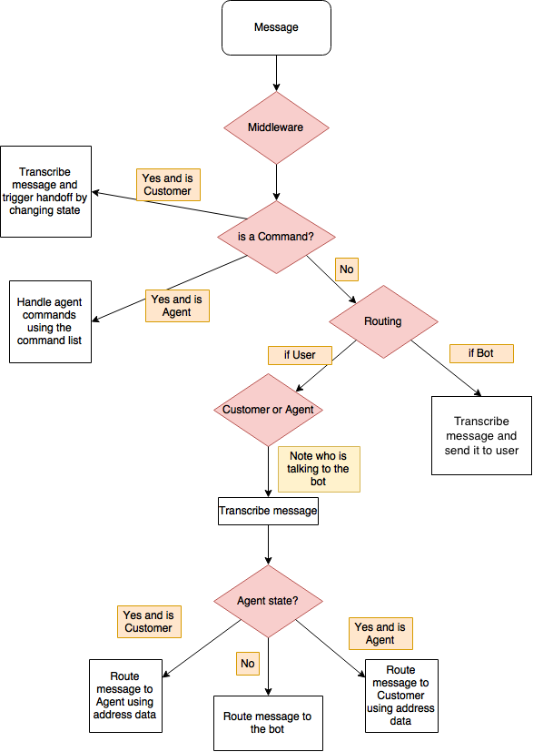
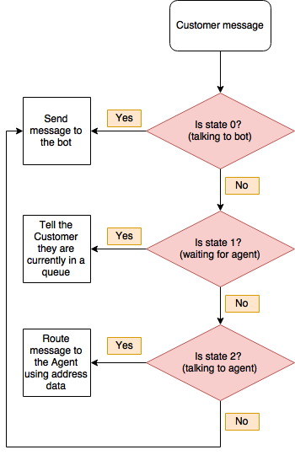
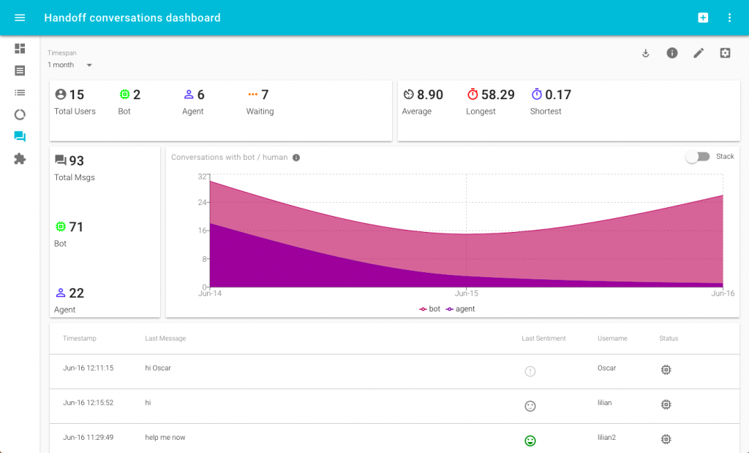
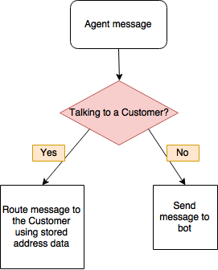
Bot to human handoff
Scenarios
Triage
Escalation
Supervision
Transitioning control
Routing messages between user and agent
Common patterns
Notes:
Transition conversations from bot to human: https://docs.microsoft.com/en-us/azure/bot-service/bot-service-design-pattern-handoff-human
Bot to human handoff in Node.js: https://www.microsoft.com/developerblog/2017/06/30/bot-to-human-handover-in-node-js/
Analyzing bot to human handoff interactions: https://www.microsoft.com/developerblog/2018/02/05/human-handoff-dashboard/
Bot handoff sample code and implementation instructions (Node.js): https://github.com/palindromed/Bot-HandOff
Botbuilder-handoff npm module: https://www.npmjs.com/package/botbuilder-handoff

Slide 23
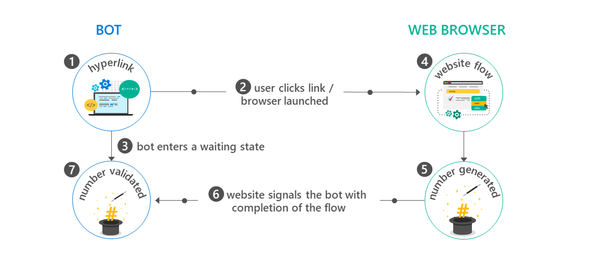
Bot to web browser and back
Bot to web browser and back
WARNING:
Transitioning from chat to web browser and back is not ideal, as switching between applications can easily confuse a user. To provide a better experience, many channels offer built-in HTML windows that a bot can use to present applications would otherwise appear in a web browser. This technique allows the user to remain within the conversation while still accessing external resources. This approach is conceptually similar to mobile applications managing authorization flows using OAuth within embedded web views.
Common patterns
Notes:
Bot to web documentation: https://docs.microsoft.com/en-us/azure/bot-service/bot-service-design-pattern-integrate-browser
Bot Authentication samples (v3 SDK): https://github.com/MicrosoftDX/botauth
Example of bot to web browser for authentication: https://blogs.msdn.microsoft.com/uk_faculty_connection/2016/06/17/developing-a-microsoft-health-bot-based-on-data-captured-from-the-microsoft-band/
Authentication library for the v4 SDK (.NET): https://github.com/Microsoft/botbuilder-dotnet/tree/master/libraries/Microsoft.Bot.Connector/Authentication
Authentication library for the v4 SDK (Node.js): https://github.com/Microsoft/botbuilder-js/tree/master/libraries/botframework-connector/lib/auth
Consider each step of the flow:
The bot generates and displays a hyperlink that will redirect the user to a website. The hyperlink typically includes data via querystring parameters on the target URL that specify information about the context of the current conversation, such as conversation ID, channel ID, and user ID in the channel.
The user clicks the hyperlink and is redirected to the target URL within a web browser.
The bot enters a state awaiting communication from the website to indicate that the website flow is complete.
Tip
Design this flow so that the bot will not permanently remain in the 'waiting' state if the user never completes the website flow. In other words, if the user abandons the web browser and starts communicating with the bot again, the bot should acknowledge, not ignore that input.
The user completes the necessary task(s) via the web browser. This could be an OAuth flow or any sequence of events required by the scenario at hand.
When the user completes the website flow, the website generates a ‘magic number’ and instructs the user to copy the value and paste it back into the conversation with the bot.
The website signals to the bot that the user has completed the website flow. It communicates the 'magic number' to the bot and provides any other relevant data. For example, in the case of an OAuth flow, the website would provide an access token to the bot.
The user returns to the bot and pastes the 'magic number' into the chat. The bot validates that 'magic number' provided by the user matches the expected value, verifying that the current user is the same user who previously clicked the hyperlink to initiate the website flow.

Slide 24
Bots in websites
Authentication
Azure Bot Service makes it easier to implement
Eliminates magic code verification for some clients
Prior, your bot needed:
OAuth controllers and login links
To store the target client IDs and secrets
Perform user token management
Now:
Developers no longer need to handle that, ABS will
Support for AAD v1, AAD v2, GitHub, and others
Add, delete, and configure connection settings to various OAuth identity providers from the Azure Portal
Common patterns
Notes:
Auth documentation: https://docs.microsoft.com/en-us/azure/bot-service/bot-builder-tutorial-authentication?view=azure-bot-service-3.0

Slide 25
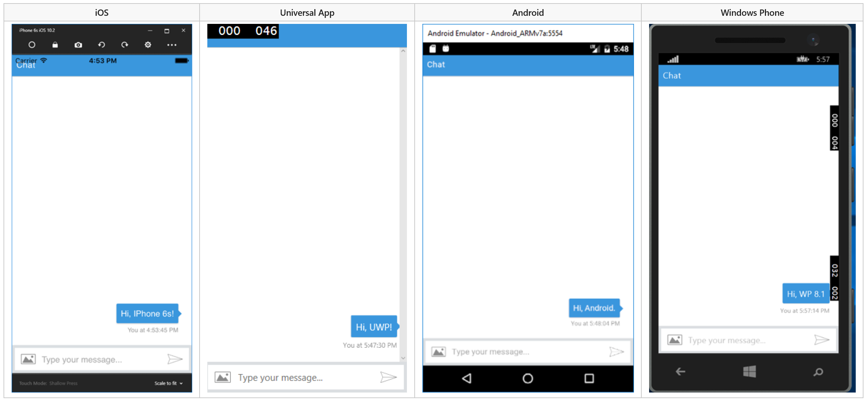
Bots in apps
Bots in apps
Common patterns
Notes:
Bots in apps documentation: https://docs.microsoft.com/en-us/azure/bot-service/bot-service-design-pattern-embed-app
Bots in apps sample (v3 SDK): https://github.com/Microsoft/BotBuilder-Samples/tree/master/CSharp/capability-BotInApps
Use open source web chat control: https://github.com/Microsoft/BotFramework-WebChat
For native mobile apps, IoT apps, and other types of apps/games use the Direct Line API: https://docs.microsoft.com/en-us/azure/bot-service/rest-api/bot-framework-rest-direct-line-3-0-concepts

Slide 26
Bots in websites
Bots in websites
Embed a bot in a website
Skype web control
Open source web control
Using the backchannel mechanism
Direct Line API
Common patterns
Notes:
Bots in websites documentation: https://docs.microsoft.com/en-us/azure/bot-service/bot-service-design-pattern-embed-web-site
Open source web chat: https://github.com/Microsoft/BotFramework-WebChat
Using the backchannel mechanism (Node.js): https://docs.microsoft.com/en-us/azure/bot-service/nodejs/bot-builder-nodejs-backchannel
Connect directly to bots with the Direct Line API: https://docs.microsoft.com/en-us/azure/bot-service/rest-api/bot-framework-rest-direct-line-3-0-concepts
How to enable bots for Direct Line: https://docs.microsoft.com/en-us/azure/bot-service/bot-service-channel-connect-directline

Slide 27
New Bot Framework SDK v4
V3 SDK issues
V4 SDK goals
V4 SDK architecture

Slide 28
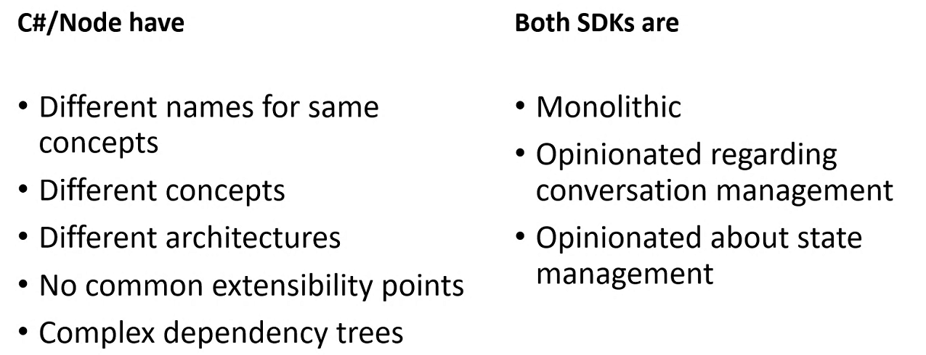
V3 SDK issues
V3 SDK issues
Bot Framework v4
Notes:
Why?
There are two main reasons:
C#/Node.js SDKs in v3 are vastly different. There are different names for the same concepts, different concepts, different architectures, no common extensibility points, and complex dependency trees.
Both SDKs are too opinionated, regarding conversation management and state management.

Slide 29
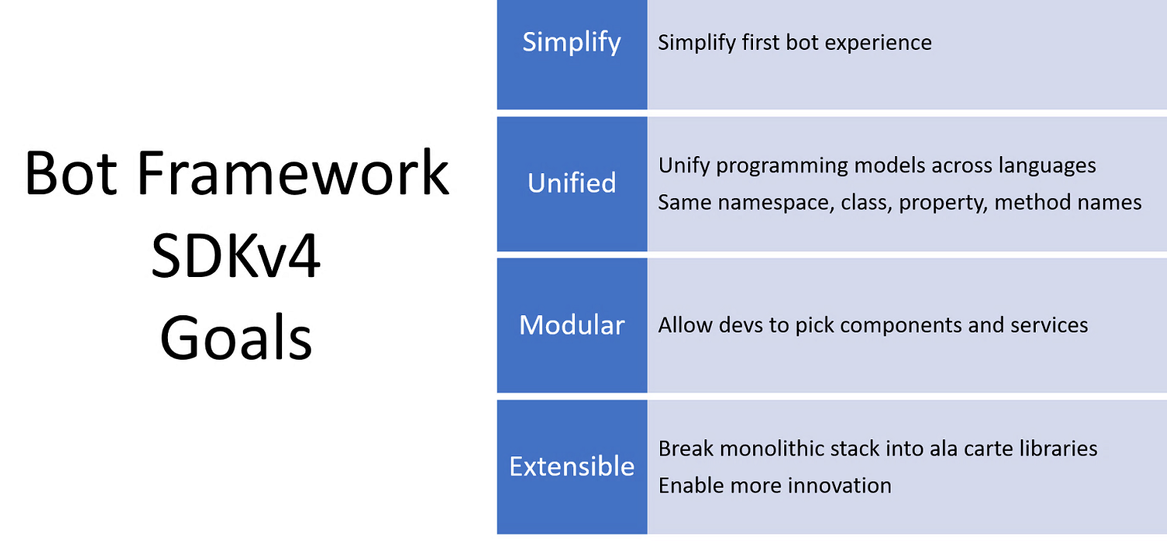
V4 SDK goals
V4 SDK goals
Bot Framework v4
Notes:
So, as you might've guessed, the Bot Framework v4 SDK had four related goals:
Simplify
Unify programming models across languages
Allow developers to pick components and services
Break monolithic stack into a la carte libraries to enable more innovation

Slide 30
10:15-2: Building Intelligent Bots

Slide 31
10:15-2PM (break 11-11:15, 12-1) Tip: go slow, read carefully, don’t skip steps https://github.com/Azure/LearnAI-Airlift TIP: Make sure you create EchoBot NOT BasicBot in Portal
Lab 6: Building Intelligent Bots

Slide 32
12-1: Lunch

